Slide 1
Student Performance Analysis & Prediction
Manzi Arsene
Introduction to Big Data
2 August 2025

Slide 2
Introduction
Sector: Education
Problem Statement: "Can we analyze and predict student performance based on socio-economic and academic factors?"
Tools: Python, Power BI

Slide 3
I. Sector Selection
Sector: ☑ Education
Share link to GitHub (once uploaded): Link: https://github.com/Manzii13/Student-Performance-Analysis
II. Problem Statement
"Can we analyze and predict student performance based on demographic, parental, and preparation factors to identify key areas for academic improvement?"
III. Dataset Identification
Dataset Title: Students Performance Dataset
Source Link: (If from Kaggle or provided in class – add actual link) Link : https://www.kaggle.com/spscientist/students-performance-in-exams
Number of Rows and Columns: Approximately 1000 rows × 8 columns (before preprocessing)
Data Structure: ☑ Structured (CSV)
Data Status: ☑ Requires Preprocessing

Slide 4
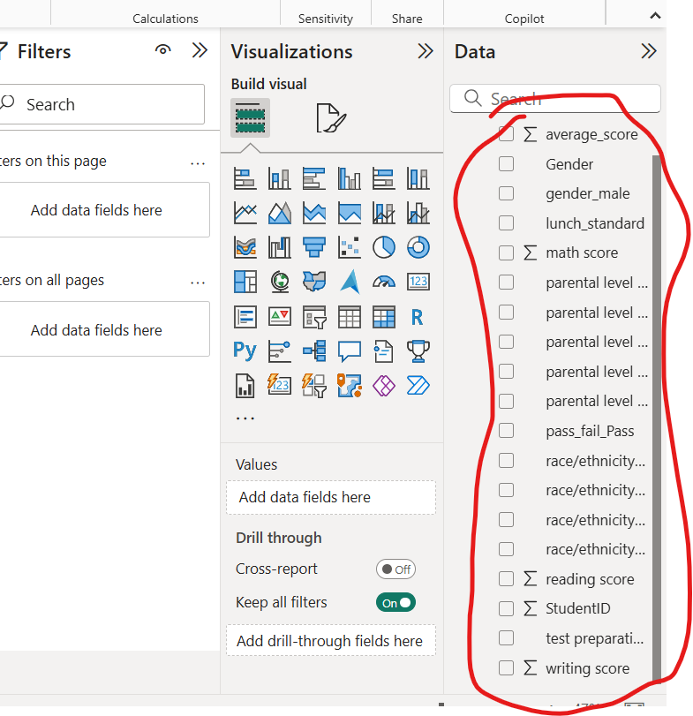
Dataset Overview
Rows & Columns: (e.g., 1000 rows × 8 columns)
Features: Gender, Race/Ethnicity, Parental Education, Lunch Type, Test Prep, Scores
New Columns Added: Average Score, Pass/Fail, StudentID

Slide 5
Data Cleaning & Preprocessing
Handled missing values (mode/median)
Removed outliers using IQR
One-hot encoded categorical variables
Added Pass/Fail & StudentID

Slide 6
Exploratory Data Analysis
Distribution of Math Scores: Most students scored between 60–80
Boxplot (by Gender): Males slightly outperformed females in math
Correlation Heatmap: Strong correlation between subjects & average score

Slide 7
Slide 6: Machine Learning Model
Model: Random Forest Regressor
Target: Math Score
Metric: RMSE (Root Mean Squared Error)
Results: (e.g., RMSE = XX.X)

Slide 8
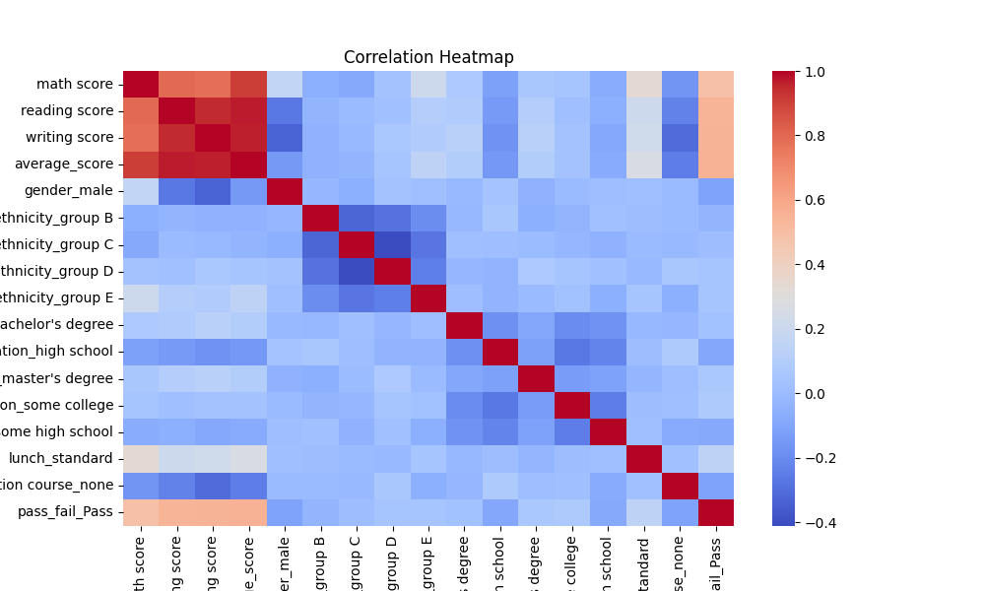
Correlation Heat map
This is a correlation heatmap of your dataset, showing how strongly different variables are related to each other:
Dark red areas (close to 1.0) → Strong positive correlation (as one increases, the other also increases).
Dark blue areas (close to -1.0) → Strong negative correlation (as one increases, the other decreases).
Light areas (near 0) → Little to no correlation.
Key Observations:
Math, Reading, Writing, and Average Score
These are highly correlated (dark red) → makes sense since average is derived from these scores.
Pass/Fail vs Scores
Positive correlation with all scores (students with higher scores are more likely to pass).
Lunch Type & Test Prep
Slight correlation with performance → students with standard lunch and completed test prep tend to perform a bit better.
Parental Education
Mild positive correlation with scores → higher education levels are linked to better performance.
Gender & Ethnicity
Low correlation with scores (light colors) → indicates gender and ethnicity don’t strongly affect the scores in this dataset.
This heatmap helps quickly see which variables are most relevant when predicting student performance.

Slide 9
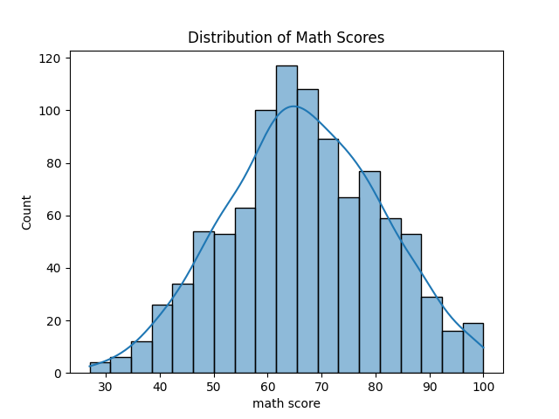
Distribution of Math Scores
The distribution of math scores shows how students performed in mathematics:
Shape: The scores are roughly bell-shaped, meaning most students cluster around the middle range.
Center: The majority of students scored between 60–80.
Spread: A few students scored very low or very high, but extreme outliers are rare.
Insight: Performance in math is fairly balanced, with no strong skew toward very low or very high scores.

Slide 10
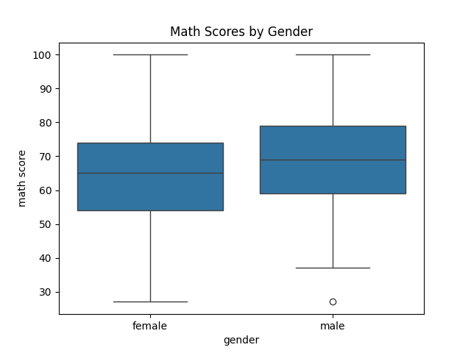
Math Scores by Gender
This boxplot of math scores by gender shows:
Median: Males have a slightly higher median math score than females.
Spread: Both genders have a similar range of scores, though males show slightly more variation.
Outliers: A few outliers exist for males at the lower end (very low scores).
Insight: While both genders perform similarly overall, males tend to score slightly higher in math on average.

Slide 11
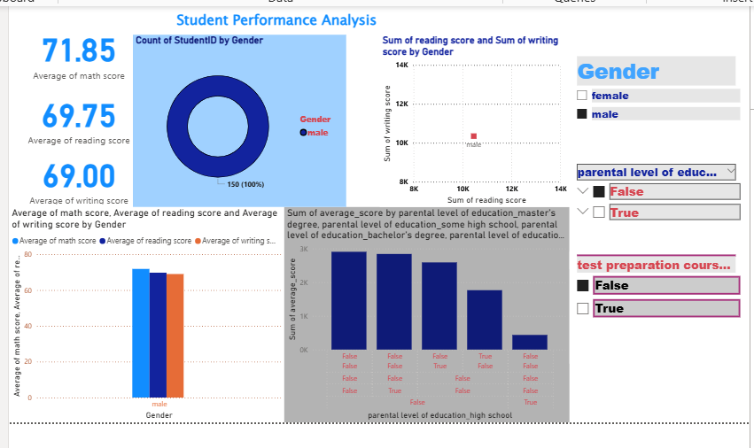
Power BI Dashboard
KPIs: Average Math, Reading, Writing Scores
Donut Chart: Pass vs Fail
Bar Chart: Scores by Gender
Column Chart: Scores by Parental Education
Scatter Plot: Reading vs Writing Correlation
Slicers: Gender, Education Level, Test Prep

Slide 12
Key Insights
Students who completed test prep scored higher on average.
Parental education level has a positive impact on student performance.
Gender differences in math are minor but present.

Slide 13
Conclusion & Future Work
Predictive analytics can help identify at-risk students early.
Future: Add classification model for Pass/Fail prediction.
Potential to integrate with real school datasets for deeper insights.

